Slide 1
Integrating Business Intelligence and Machine Learning for Enhanced Decision Making and Data Handling in Real Estate
Arsalan Ameer Khan (21175562)
BIRMINGHAM CITY UNIVERSITY

Slide 2
Table of Contents
Introduction
Aims and Objectives
Previous Studies
Project Architecture
Data Extract, Transform and Load
Business Intelligence
Machine Learning
Model Comparison
Future Works

Slide 3
Introduction
Data is a priceless resource
In the past, real estate decisions were frequently made purely on gut feeling and scant knowledge.
Stakeholders now have access to a wide variety of data, including transaction histories, demographic insights, and market trends as well as property listings.
Difficulty in Managing Real estate data because of Variety of sources.
Organising Data for Decision making and Data management.
Real estate makes up a sizeable portion of the GDP and is a crucial gauge of the state of the economy of Canada.
Traditional data analysis techniques frequently fall short of capturing the complex relationships and patterns found in the real estate market. However, the development of business intelligence (BI) and machine learning (ML) approaches has created new opportunities for enhancing decision-making

Slide 4
Aims
To investigate the possibility for combining machine learning and business intelligence methods in the real estate industry
To investigate how decision-making might be improved in the real estate market by using business intelligence and machine learning.
To create cutting-edge data handling techniques for real estate data using BI and machine learning.
Notes:
Spark was initiated at UC Berkeley in 2009 and was transferred to Apache Software Foundation in 2013.
Since then, Spark has become a top level project with many users and contributors worldwide.
Hadoop is great for batch processing using the MapReduce programming module, however it has shortcomings in a number of ways.
1 - it is limited to Map and Reduce based transformations, one has to restrict their big data pipeline to map and reduce steps. You might have a more complicated data pipeline with
several steps including joins and group byes. It might have a Map and Reduce face, but maybe another map face after that.
2- MapReduce relies heavily on reading data from disc, each transformation will need to read its inputs from the disk, this will end up in a performance bottleneck due to IO.
Note: Most machine learning pipelines are in this category, making Hadoop MapReduce not ideal for machine learning.
3- the only programming language that MapReduce provides a native interface for is Java.
4- Most data scientist prefer to use scripting languages due to their interactive shell capabilities. Not having such an interface in Hadoop really makes it difficult to use and
adapt my many in the field.
5- No support for streaming
Spark provides simple APIs for Python, Scala, Java and SQL programming through an interactive shell to accomplish analytical tasks through both external and its built-in libraries.

Slide 5
Objectives:
Identify the main issues that the real estate business faces with decision-making and data processing.
Examine how business intelligence contributes to the process of drawing conclusions from real estate data.
Look into several machine learning techniques that are appropriate for analysing and predicting real estate data.
Create a framework for incorporating business intelligence and machine learning strategies into the choice-making process for real estate.
Utilising dataset related to real estate, implement and assess the proposed framework.
Analyse the effect of the integrated strategy on the quality and effectiveness of decision-making in the real estate industry.
Give advice on how business intelligence and machine learning solutions should be used and used in the real estate sector.

Slide 6
Previous Studies
Price Prediction and Validation:
"Predicting House Prices with Machine Learning Models" written by Yu Bao, Yu He, Yu Wu, and Yu Fan.
Focus: A crucial component of real estate assessment, the application of machine learning models to anticipate house prices is explored in this study.
Market Analysis and Trend:
Research: R. Moraes' "Real Estate Market Analysis Using Big Data Analytics"
Focus: Examine and comprehend market patterns in the real estate industry, assisting investors and developers in making wise decisions.
Risk Assessment:
"Real Estate Risk Assessment Using Data Analytics" co-authored by He, S., Wong, R. K. W., and Xu.
Focus: Evaluating market and financial risks as well as other hazards related to real estate transactions.
And Much more highlighted in Master Project Report.

Slide 7
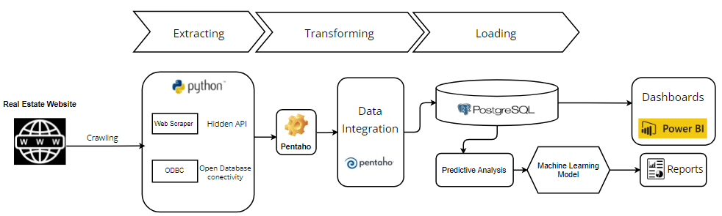
Project Architecture

Slide 8
Data Extraction
Requesting data from website by web scrapping.
Checking status of the data.
Data which was needed is append into a Panda’s Dataframe.
Data loading into PostgreSQL with the help of ‘SQL AlChemy’

Slide 9
Data Transformation
Data which was extracted from realtor.ca as mentioned above loaded into PostgreSQL as in Raw format.
Transformation taken place in Pentaho.
ERD Diagram designed to show tables relation with each other.
Data transformation pipeline made.

Slide 10
ERD Diagram
One to one relation
Property Master to Property Address
Property Master to Building
Property Master to Real estate scrap data
One to Many relation
Property Master to Media
Many to one relation
Property Master to Agent
Property Master to Organization
Many to Many relation
Property Master to Property

Slide 11
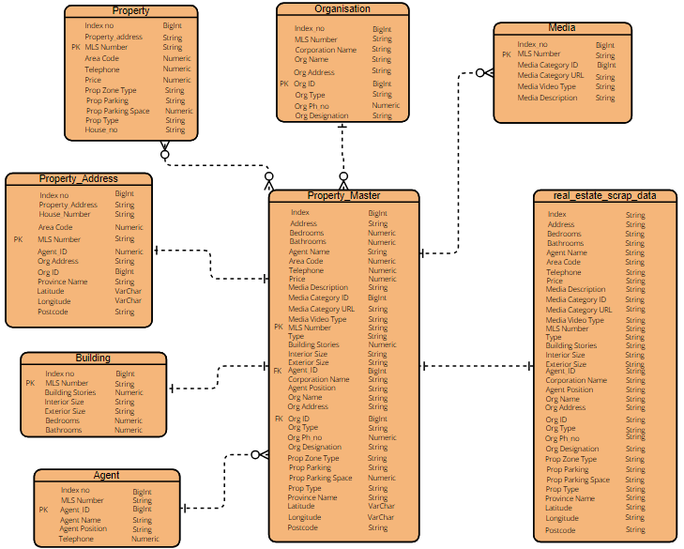

Slide 12
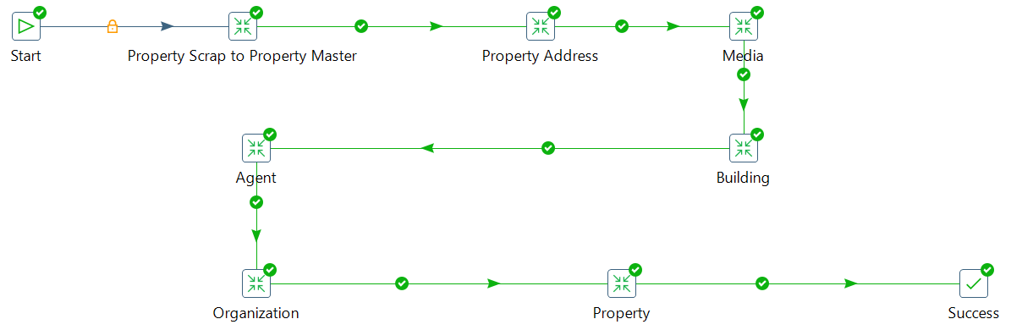
Data Transformation Pipeline
Data Cleaning
Raw table to Main table
Data Transfer
Property table to different correlational tables

Slide 13
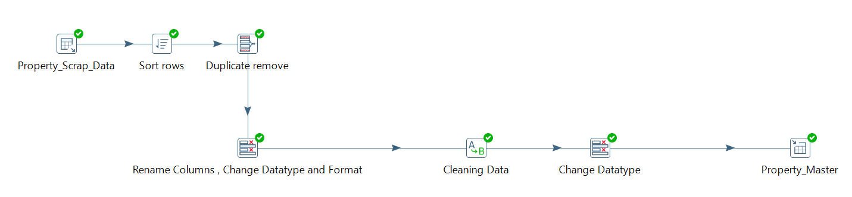
Data Cleaning
Removing Duplicates
Rename Columns
Change datatype
Change Format
Cleaning Data
Contains anomalies
Changing datatype
Loading to Main table

Slide 14
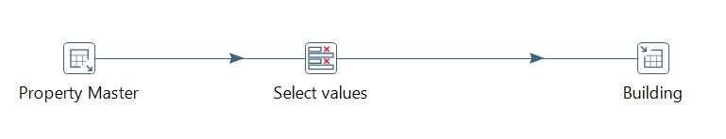
Data Loading
Data in Property Master to Other related tables

Slide 15
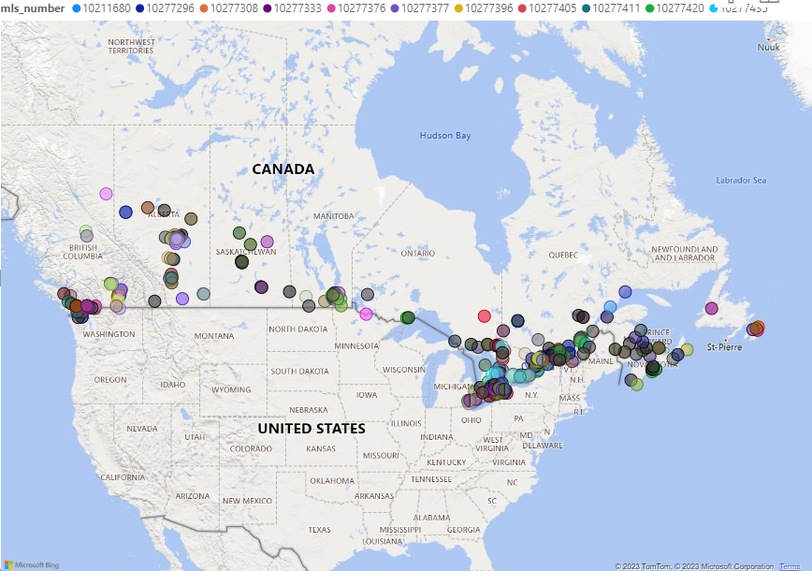
Business Intelligence
Use of data analysis and visualisation tools to derive actionable insights and enable data-driven decision-making within the real estate sector.
Data visualization tool used is PowerBI
Geolocation of all the Properties on Realtor.ca

Slide 16
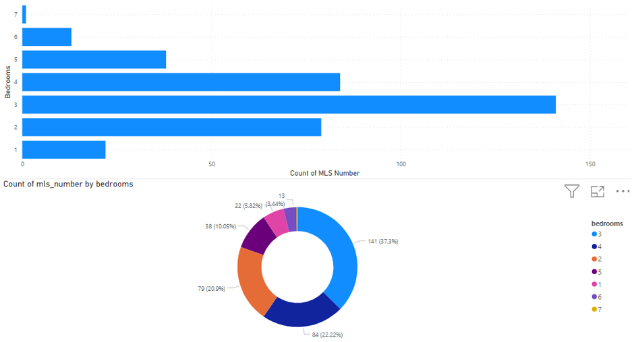
Data visualization of Bedrooms in number of properties

Slide 17
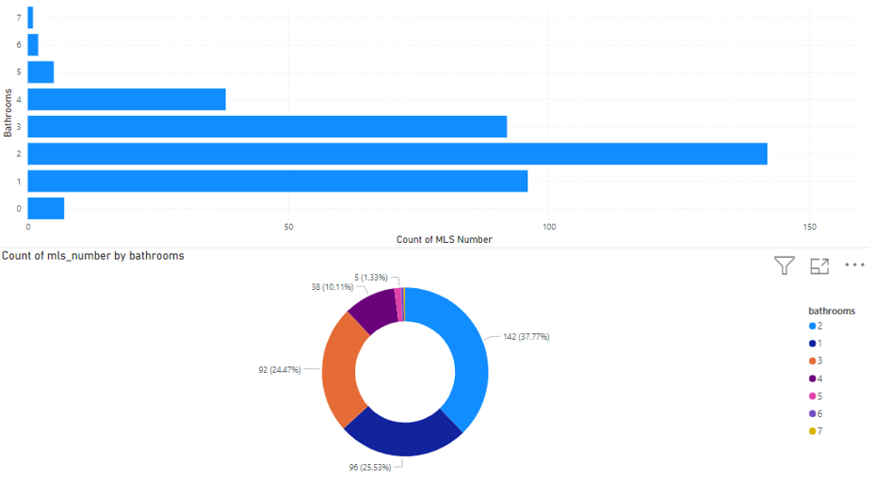
Data visualization of Bathrooms in number of properties

Slide 18
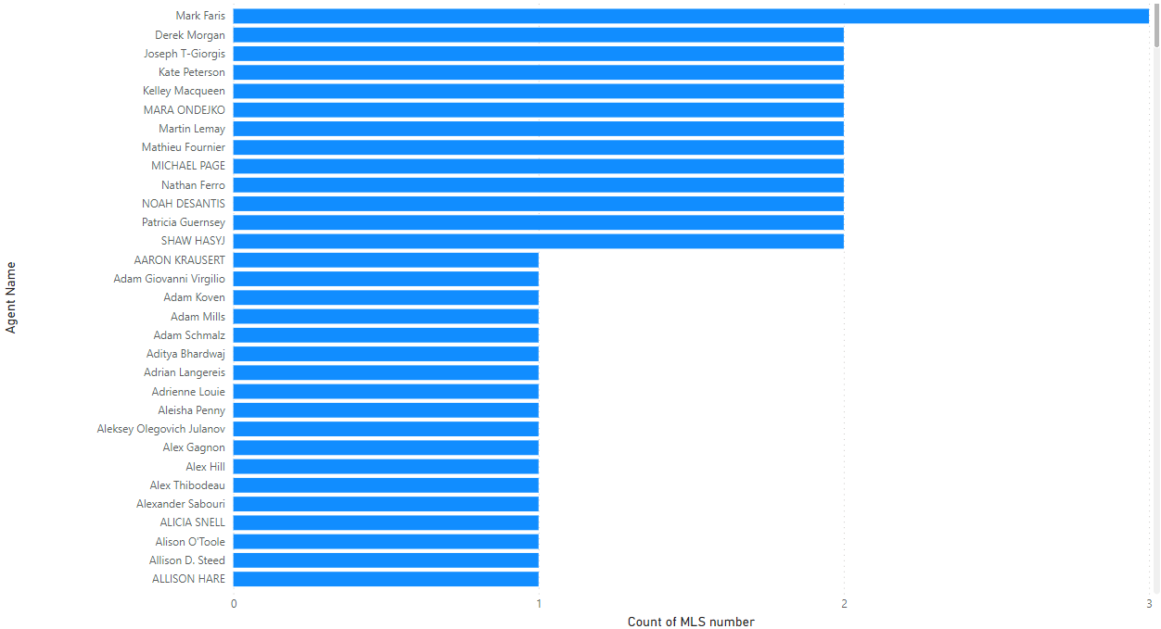
Count of MLS number by Agent name

Slide 19
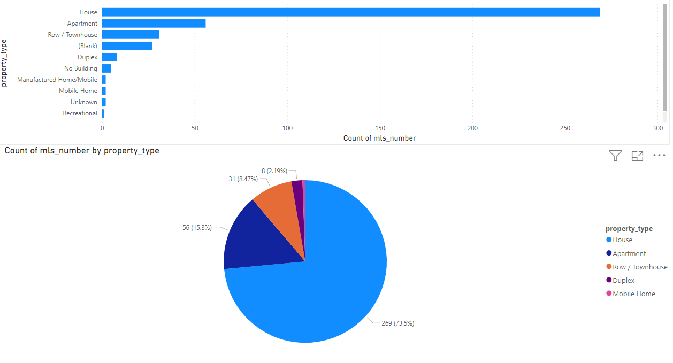
Count of MLS_number by Property_type

Slide 20
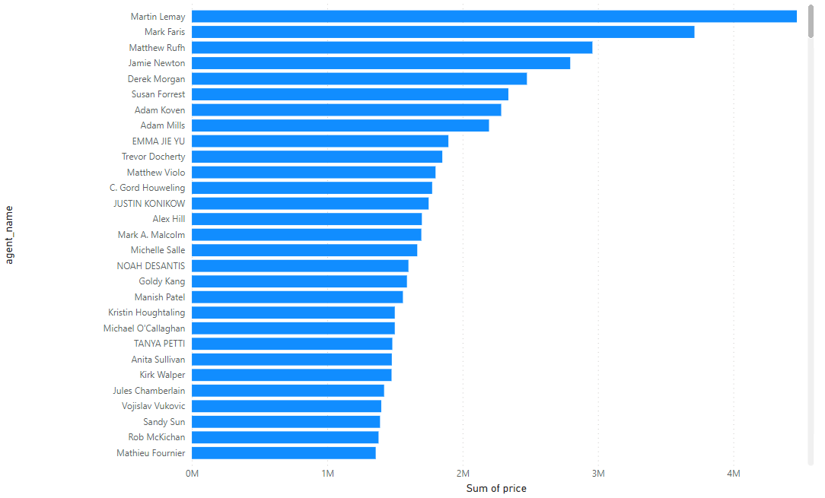
Sum of Price by Agent name

Slide 21
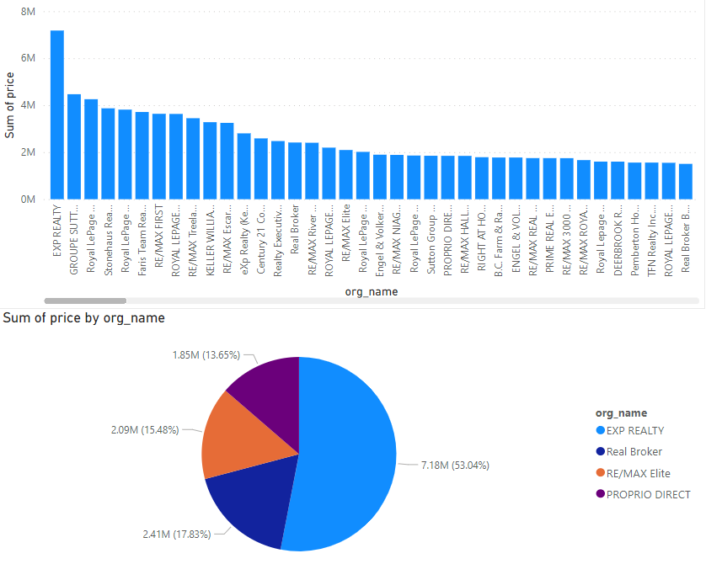
Sum of price by Organization name

Slide 22
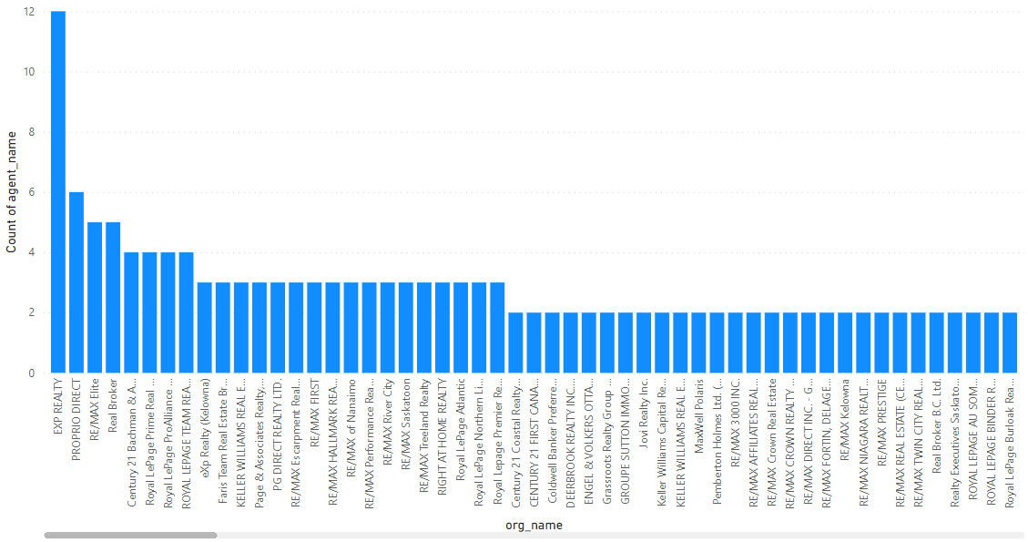
Sum of Agent name by Organization name

Slide 23
Machine Learning
Data Cleaning
PostgreSQL database
Exploratory Data Analysis (EDA)
Checking the shape and size of the dataset.
Missing or null values in columns
statistical summary of dataset
Visualizing the correlations between numerical variables in the dataset
Feature Selection
Selecting numerical features 0.40 or less than -0.40 correlation rate based on Pearson Correlation Method

Slide 24
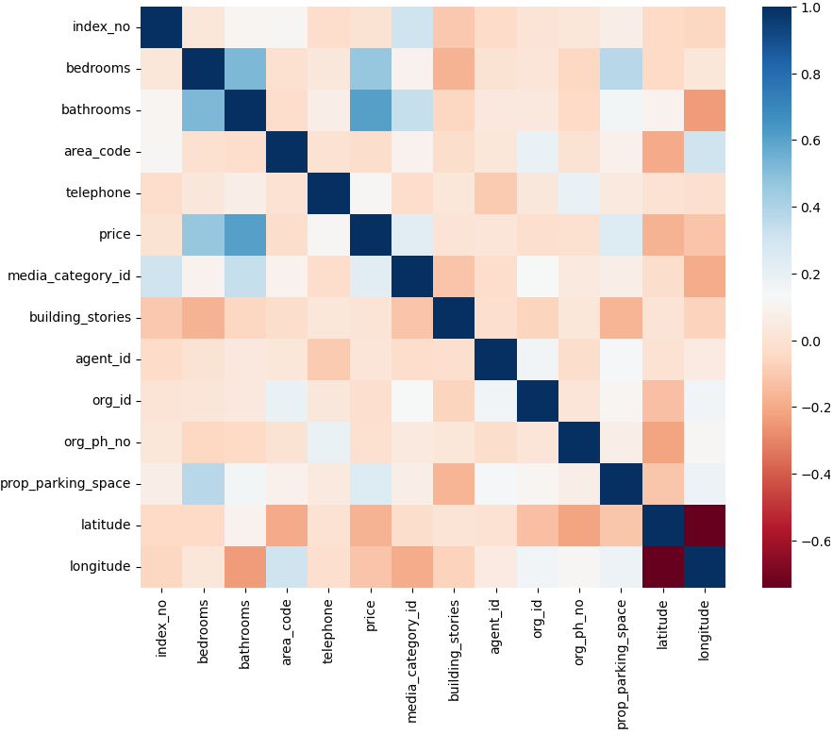
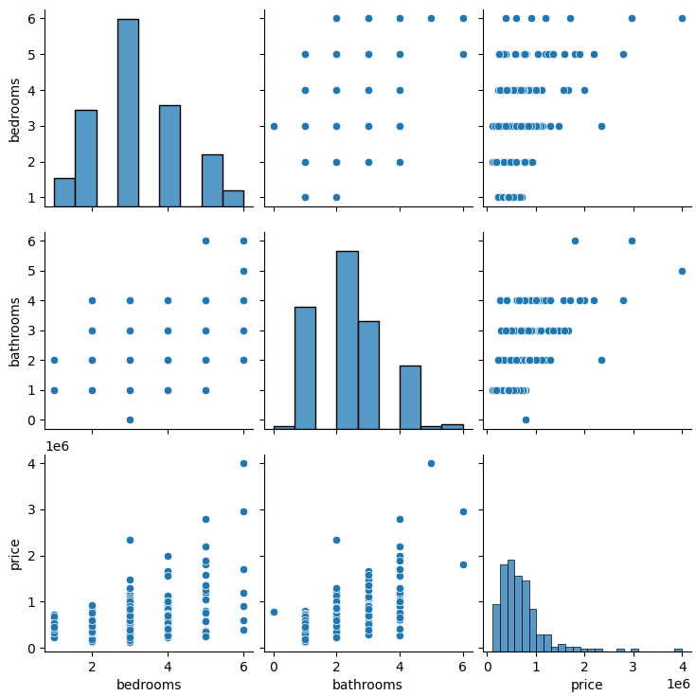
Correlations between Numerical variables Data visualization of correlated numeric columns

Slide 25
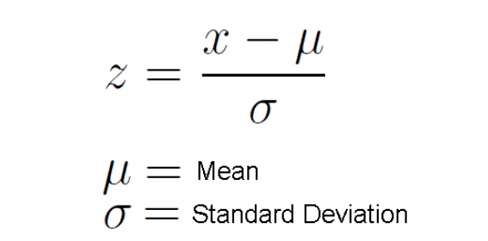
Data Standardising and Splitting
Split and Encoding
The dataset has been divided into X and Y Dataset, where X is the bedrooms and bathrooms data without Price and Y is the Price data solely.
One-Hot Encoding has been applied in which Encoding the categorical features in X dataset.
Standardising the data
Standardizing the numerical columns in X dataset.
StandardScaler() adjusts the mean of the features as 0 and standard deviation of features as 1.
Train-Test Split
Splitting dataset into 2 chunks where 20% of the data is stored in test and 80% of the data is stored in for training the models

Slide 26
Fundamental Ideas and Metrics:
Mean Absolute Error (MAE):
The mean absolute difference between the expected and actual values is measured by MAE.
A lower MAE denotes higher performance and offers a clear insight of prediction accuracy.
Mean Squared Error (MSE):
MSE computes the mean of the squared differences between the expected and actual values.
A lower MSE value denotes improved model performance.
Root Mean Squared Error (RMSE)
Is the square root of Mean Square Error (MSE).
Similar to MSE, lower RMSE values signify better accuracy, and it is similarly outlier sensitive.
R-squared (R2) Score:
R2 gauges how much of the variance in the target dependent variable (the target) can be attributed to the model's independent variables (the features).
A high R2 indicates that the model sufficiently accounts for the data's variation.
Cross-Validation:
cross-validation is a technique used to evaluate a model's performance.
Each fold serves as both a training and a validation set since the model is trained and assessed several times.
This improves the model's performance estimate and aids in the detection of overfitting.

Slide 27
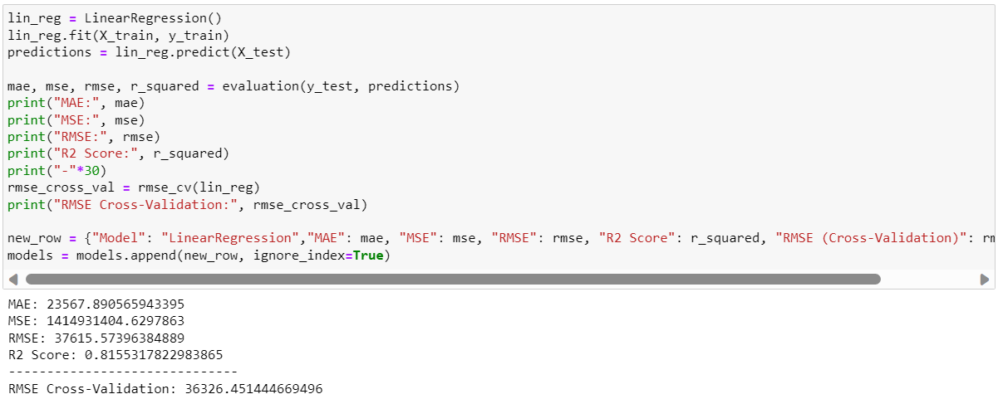
Linear Regression

Slide 28
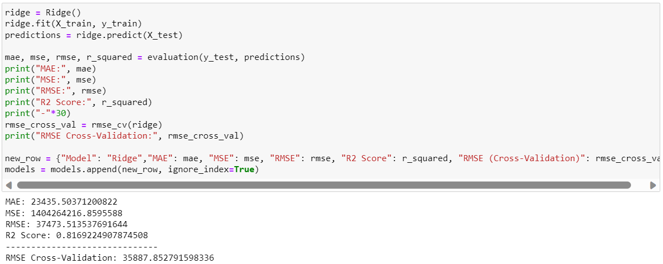
Ridge Regression

Slide 29
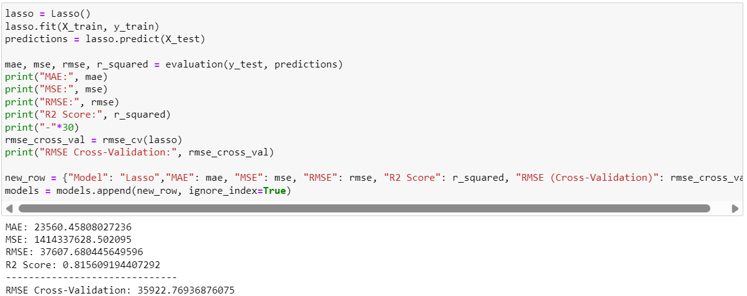
Lasso Regression

Slide 30
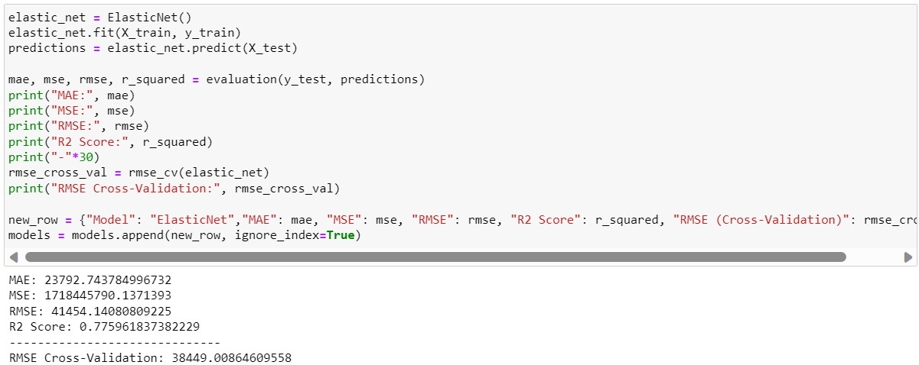
Elastic Net

Slide 31
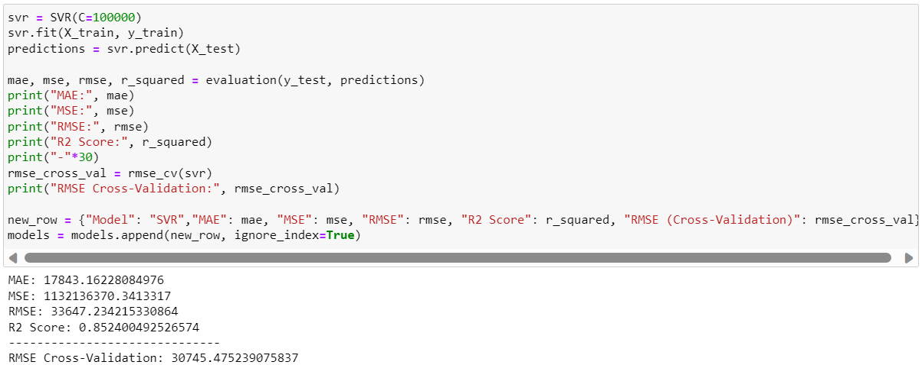
Support Vector Machine (SVM)

Slide 32
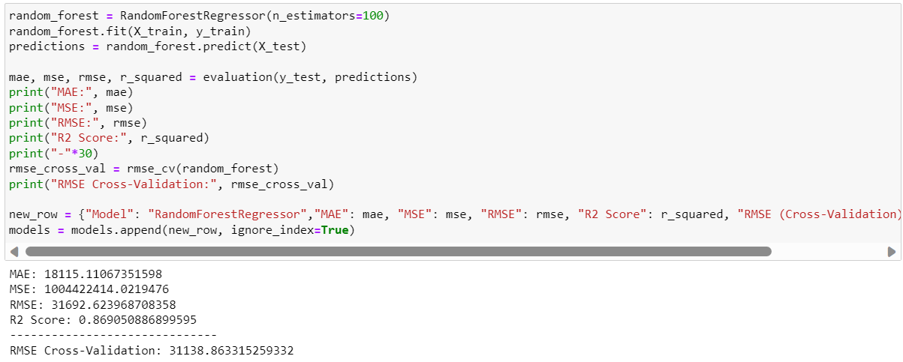
Random Forest Regressor

Slide 33
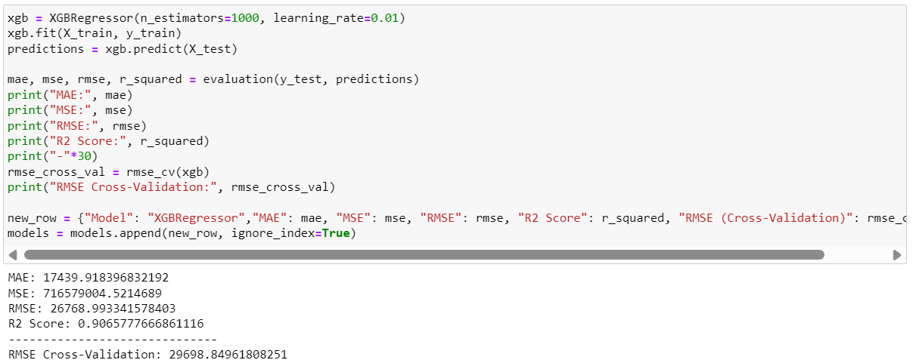
XG-Boost Regressor

Slide 34
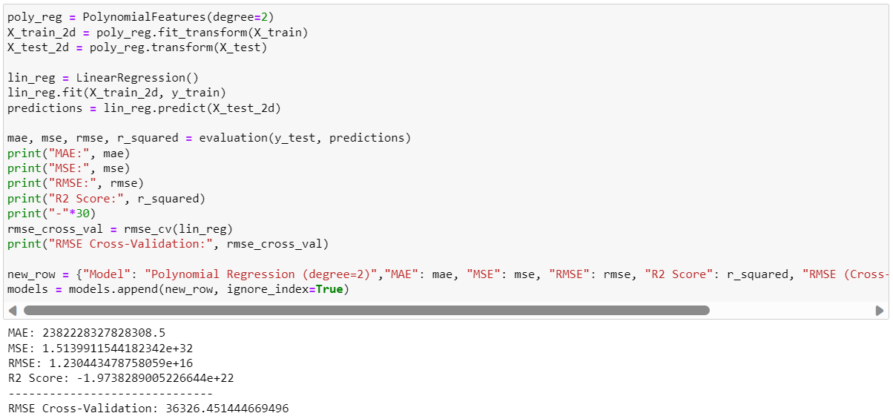
Polynomial Regression

Slide 35
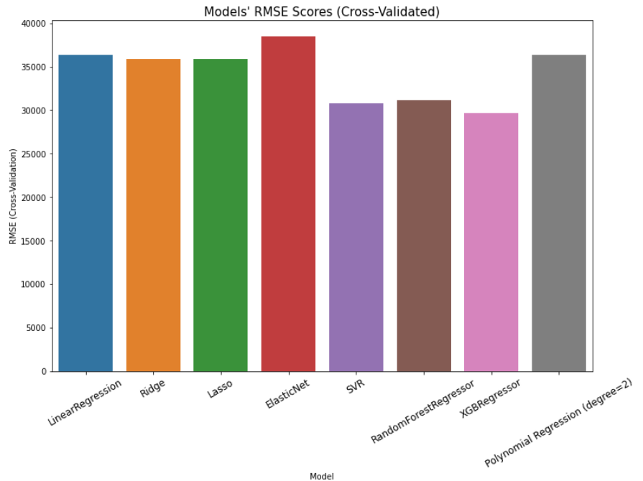
Model Comparison

Slide 36
Future Works
New Algorithm: Even after all the effort and thought put into the conclusion, a more accurate algorithm than the ones employed in this thesis may yet be developed, or a new algorithm that provides insightful real estate data may be discovered.
Automation: We can automate this entire process in light of the fact that the data taken was only current data, schedule the automation for daily execution, and get updated insights from the advertising posted on Realtor.ca. We can also store the data for future analytics in database.
Own Website: We can make our own website and link it with the database of this project upon which customers can easily search for house of their need. A website made on PHP can be linked to this database by simply putting trigger command on the relevant tables.

Slide 37


